Slide 1

WEEK 4- Lesson 2
Using Firebase In A React App

Slide 2
Today’s Objectives
You will understand what a document-oriented database is (e.g., Cosmos DB, MongoDB, Firebase)
You will be able to create a new 'app' in Firebase
You will be able to create, read, update, and delete information in their Firebase database using the Firebase website
You will be able to access their Firebase database programmatically, including the normal CRUD operations

Slide 3
Resources
Week 4-Lesson 2
Using Firebase In A React App
Code example

Slide 4
Set up a Firebase project

Slide 5


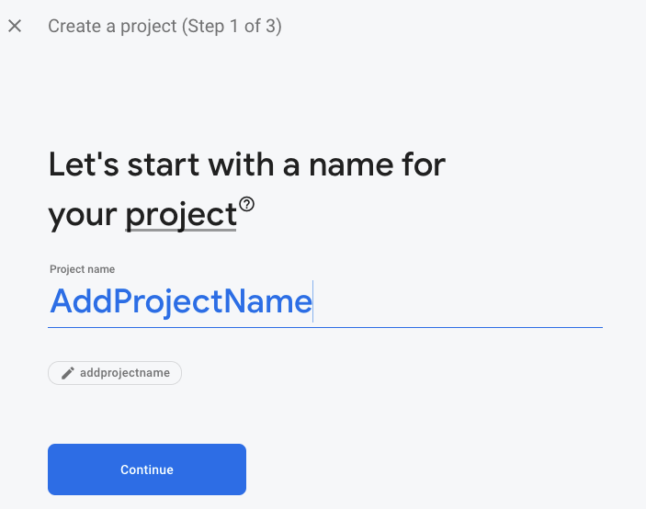
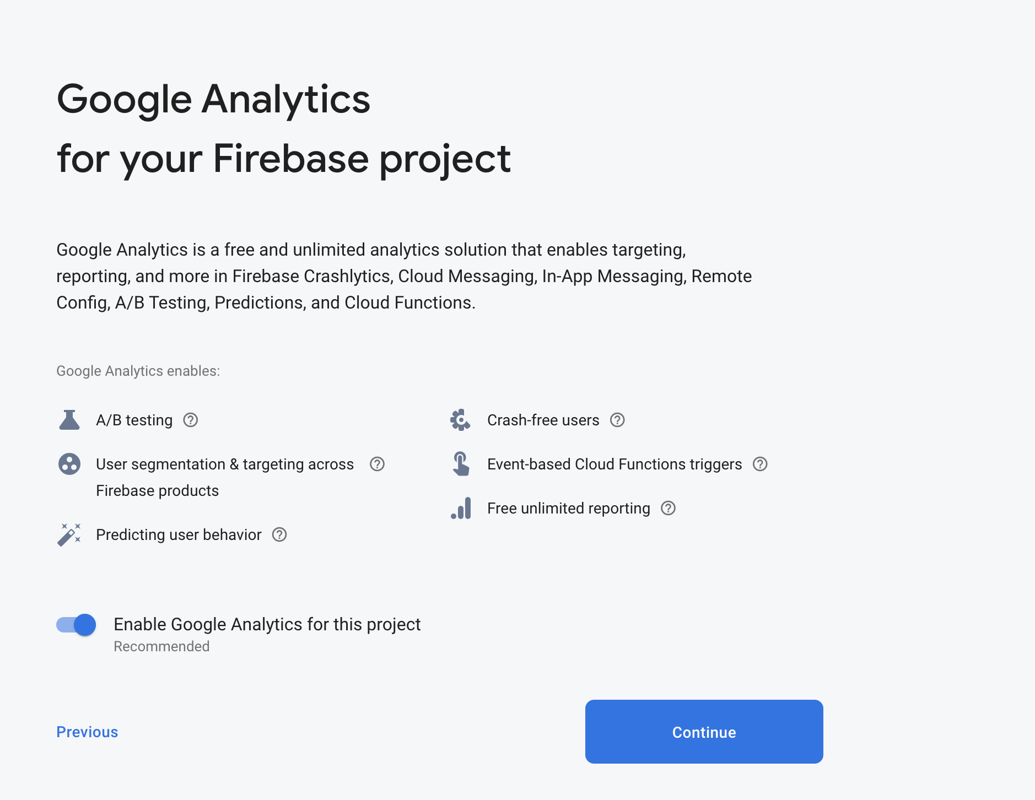
Sign up
Sign up for Firebase on their website. (It's free)
Set up
Set up a Firebase project Step-by-step guide
Pick
Pick a name
Say
Say 'No' to Google Analytics :)

Slide 6
Add Data To The Database
Next, you'll need to create a new database by clicking on the 'Create Database' button in the above picture

Slide 7
The web page will then ask you where you'd like to physically locate the database. The general rule is "close to where my users/customers are" because it's quicker to access stuff that's closer by, even on the Internet. The closest choice for me is "United States" so let's go with that, then click 'Next’:

Slide 8
Your database will start out empty, if you move the mouse over an element, you'll be given the option to add sub-items or to remove the item
Notes:
Your database will start out empty, if you move the mouse over an element you'll be given the option to add sub-items or to remove the item:

Slide 9
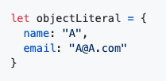
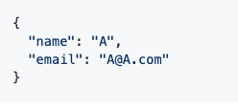
Firebase is a Document Base DB. It uses JSON
JSON file are very similar to object literals in JavaScript (and therefore similar-ish to object literals in JavaScript) but there are differences. For example, and object literal in JS does not need to put quotes around the field names...
...but JSON files do need the quotes::
Object literal in JavaScript
JSON Data
Notes:
There's no rules enforcing a certain structure, nor limiting what you can do with this.
On the one hand this is nice because you can add extra information or fields to any given part of the document, which can be handy (especially in web application development, because the browser will send the server a bunch of strings and these strings may or may not be consistent each time).
On the other hand, computers are best at doing the exact same thing over and over, so when you've got a document that may have variations in the structure that may complicate your code
You CANNOT have circular references in the document
There are ways around this. For example, instead of a reference you could put in an ID number, and then put stuff into the document in way that allows you to look up objects by ID number.
You CANNOT put comments into JSON files (at least officially) Because this was intended as a format for one program to send information to another program there's no way to add comments. :(

Slide 10
How do we access the database from code?
We'll need to create an 'app' on the Firebase website before we can have our program (our React web app) use the database. There are multiple ways to find this, but we'll start by clicking on the Project Overview link in the top-left:
Notice that there's an option for iOS and another for Android - we'll use the web application option:
When Firebase asks make sure that you do give it a name but do NOT host your solution on Firebase
Once you've done that it'll show you a Wall of Code. Copy it and paste it into a new file (just so you don't lose it on the clipboard)

Slide 11
If you need this code again you can find it in your Project Overview > Project Settings page:
On the 'General' tab (in the Project Overview > Project settings page) scroll down to the 'Your Apps' section, and you'll find that same info (clicking on the 'Config' button will even give you usable JavaScript/JavaScript):

Slide 12
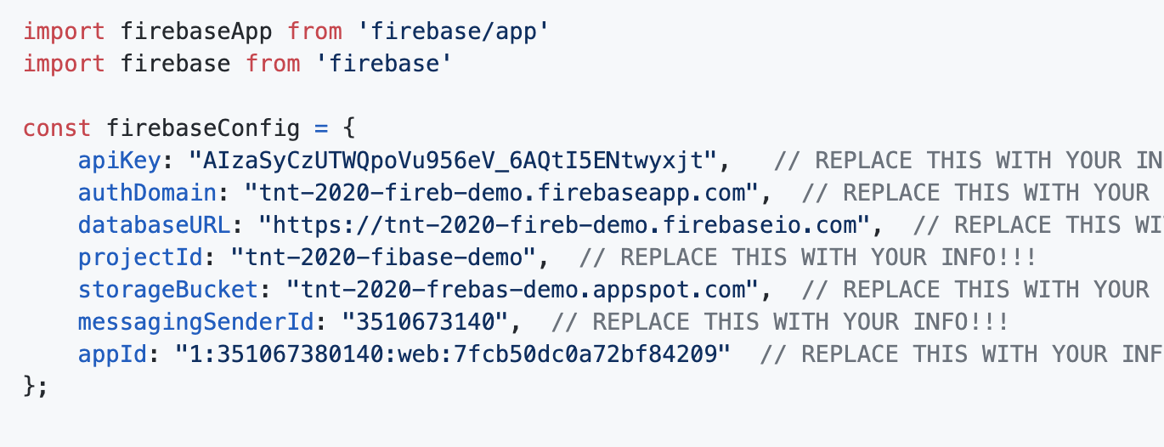
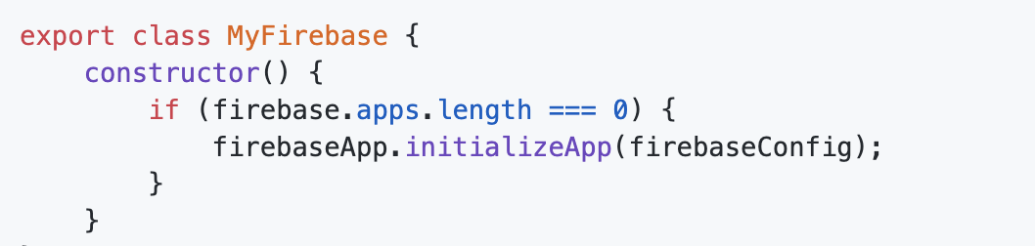
Setting up your React app
Install the Firebase support in your terminal like this:
npm install firebase
Create myFirebase.js to add all the configuration
Initialize the connection to the database, do that exactly once in the program. We can make this easy by putting the following code into the constructor:

Slide 13

Your Turn

Slide 14
Activity 1
Create Firebase account,
Create a new Database
Try to re-create the picture below in your own Firebase DB.
Copy The project config to Myfirebase.js file to replace the placeholders
Notes:
E tiT configTry to re-create the picture above in your own Firebase DB.
Try to re-create the picture above in your own Firebase DB.
Try to re-create the picture above in your own Firebase DB.

Slide 15

Break Time

Slide 16
Setting up your React app
Inside any other file that you want to use Firebase in you'll need to put this at the top of the file:
import { MyFirebase } from './myFirebase';
After that you'll need to create the database in each method / function that you want to use it in, like so:
let db = new MyFirebase(); // After this you can then call methods on your 'MyFirebase' object

Slide 17
Overview of our approach to using Firebase
In each case we're going to follow the same general set of steps, whether it's adding information to our database or reading a list out. More-or-less, we'll do the following:
Create a MyFirebase object (this will connect to Firebase, if we haven't done so already)
Create a method on the MyFirebase class to interact with the database for our component. That method will then do the following:
From the firebase package, get a reference to the place in the Firebase database (the JSON document) that you want to modify
Call the appropriate method on that reference (e.g., set / push / once / update / remove )
Use Promise.then to run code once the database operation is finished
In that code we'll call this.setState in order to update React / update the page that we're showing to the user
For each of the following sections try doing the following:
Watch the new feature work in the browser
Verify / visualize what change(s) have been made in the database by using the Firebase website
Look through code in detail
Notes:
We've already got a class that will connect to Firebase for us. We're going to add a method to that class for each action you want to do on the DB. Each time you ask (query) for information, or add / update / remove information, etc - each action gets their own method. This way you can then say something like "db.addUser(firstname, lastname, etc, etc);" in the rest of your app, and this one class is the only thing that needs to worry about how to interact with the database.

Slide 19

Demo

Slide 20
CRUD: Create

Slide 21
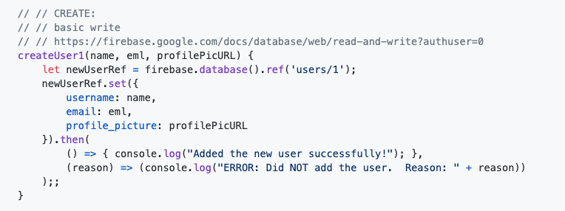
Useful for
A new order on a ecommerce site In general, whenever you've got an HTML form that's adding new information to your database then you'll want to consider using a 'create' style method on your database
If you're replacing something wholesale. For example, if you're replacing your car you might completely replace the information about your current car with the information about the new car.
When you initialize the DB with some starting values (for example, when the app is first installed)
JavaScript Promises..then() method call with the two arrow functions inside it
Notes:
Notice that this will create a new JSON object within the overall database at the users/1 location. Typically the '1' would be an ID identifying a particular user. This does mean that if we run this method twice then the second time this method will replace the contents of users/1 during that second time that it runs.
We do this by following the steps we listed above. First we get a reference to the object that we want to create (it's ok that it doesn't exist yet) using the line et newUserRef = firebase.database().ref('users/1');
Next, we call the set method and hand it a JavaScript object literal, starting on this line: newUserRef.set({
Finally, on to the third step. How do we know if the operation succeeded or not? There's any number of reasons why this might not work. We might experience some sort of connection issue across the internet, or we might run out of space in the database (particularly for the 'free' plan), or, or, or. So how do we check that things worked out ok? This is complicated by the fact that it may take a while to get the response back from the Firebase server out there on the Internet and we'd like our program to do something productive in the meantime.
We'll solve these two problems (did my DB operation work ok? how can I do something else while I'm waiting for the answer?) by using JavaScript Promises. This is that .then() method call with the two arrow functions inside it:
Essentially, if things went ok then the first function will be called (in our case, this will print out "Added the new user successfully!" ). If something goes wrong then the second function will be called.
It's really important to understand that if you want to run code only when you know for sure that the database operation has succeeded then you must run it inside that first arrow function.

Slide 22
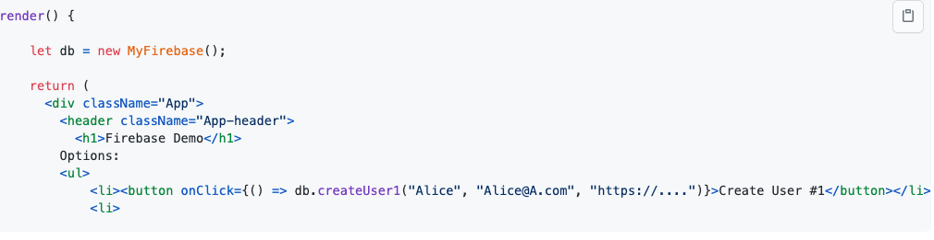
Here's how we might call the code inside, say, a render method of a component:
You only need to do the line that starts with let db = once for each method. If you wanted to do multiple database operations, you can use and reuse the db variable.

Slide 23
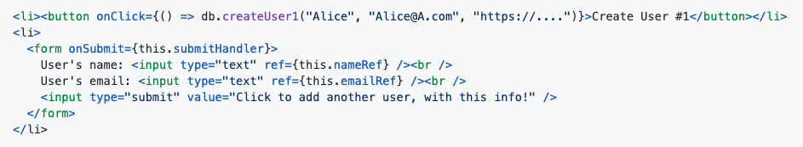
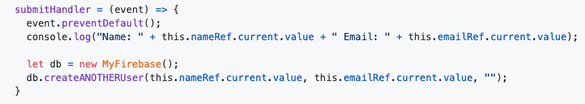
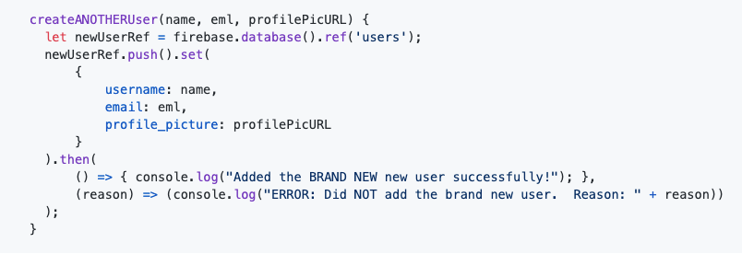
Adding another user (instead of always overwriting user #1)
In the App.js
MyFirebase.js:
Notes:
We can ask Firebase to create a new node using the push() method, which will add another node and give it a unique ID.
This is very similar to the first version - we obtain a reference to the right place in the Firebase DB (but this time we want a reference to the parent of the place where we want to add the new object - we're using users here, not users/1)(which makes sense, since we don't know what the ID number should be).
Next, we call .push() to ask Firebase to create a new object underneath the users location. Firebase will also assign a unique ID to it, as well.
Once we've done that we'll call .set() on the new object that we got back from Firebase to actually set up the new object the way we want.
The last step is to handle any errors in the .then()

Slide 24
CRUD: Read

Slide 25
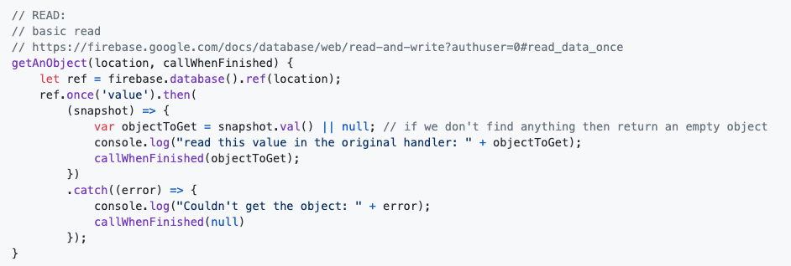
Useful for
Getting information that you'd previously stored in the database
When a user logs on you'll want to display their name, their theme, etc, etc. This is all stored in the DB and you get it once they've logged in.
If you wanted to show a list of products that are available you'd store the items in the DB and then read those values out later
Notes:
We'll ask Firebase for the current value of a particular part of the JSON document (of the database) and then wait for it to tell us what that is.
It's important to understand that because Firebase is out there on the Internet / in The Cloud that it will take some time for our request to arrive at the Firebase servers, some time for the Firebase servers to figure out their response, and it'll take some time for that response to arrive back at our computer. We do NOT want our program to just stop and wait for all this to happen. Instead what we'll do is we'll set up and send our request, JavaScript will give us an "IOU" ("I Owe You"), then we'll tell JavaScript to get back to us when we've gotten a response to that IOU. The thing that JavaScript gives us is called a Promise. We'll give JavaScript a function to call once we've received the response (aka "once the Promise has been resolved")
Also remember that there's always the possibility that something goes wrong (we lose our connection to the Internet, or maybe just to Firebase, etc, etc) so we'll have to handle any potential erros.

Slide 26
is a method on Promise objects, We tell JavaScript what function to call once the promise resolves
Once will give us back a Promise, which we can call method on
will be called if the promise is broken
Notes:
The idea is that we'll pass in a location (such as "/users/1") to get a particular object, and we'll pass in a function to call once we've gotten the reponse for Firebase. We'll call that function regardless of whether we get data or not, or get an error or not, so that the rest of our program can decide what it wants to do. If we do get an error we'll pass null so that the callback function can know that something went wrong.
The 'once' method is the method that actually asks the database for a piece of information.
\Once will give us back a Promise, which we can then call methods on.
The 'then' method is a method on Promise objects. We tell JavaScript what function to call once the promise resolves (i.e., once we get the response to our request). In this case we're giving it an anonymous arrow function. Weirdly, "then" returns the Promise. It's weird but handy - it means that we can call more Promise methods, one after the other, in a chain.
The ''catch" method will be called if the promise is broken - for example, if we've lost our connection to the Internet the program will eventually notice when our program 'times out' and stops waiting for a response.

Slide 27
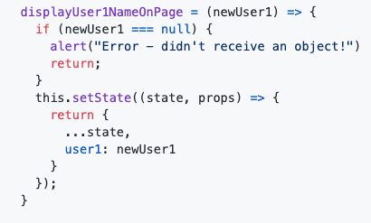
we're asking for the JSON object at /users/1 (whether that's a single string or a large complex object) and we're asking JavaScript to call this.displayUser1NameOnPage for us once it's got a response. Let's look at this.displayUser1NameOnPage next:
This method is pretty short - once we've (finally) got the value from the database we call this.setState (unless something went wrong, in which case we display an alert and then end the method early)
It also updates the React state with the new uservalue.
Here's how we might call the code inside, say, a render method of a component:
Notes:
This method looks really similar to the other method. So similar that we could probably get away with a single version instead of having two separate methods for this :)

Slide 28
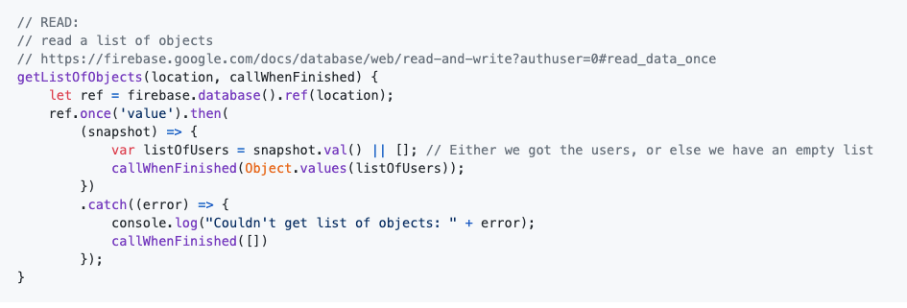
Read A List
Useful for:
Getting a list of users, or items, etc
is a method on Promise objects, We tell JavaScript what function to call once the promise resolves
Once will give us back a Promise, which we can call method on
will be called if the promise is broken
Notes:
This method looks really similar to the other method. So similar that we could probably get away with a single version instead of having two separate methods for this :)

Slide 29
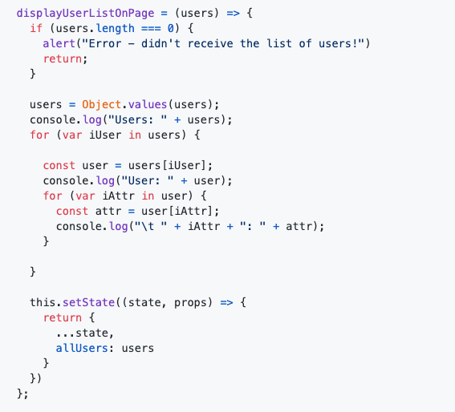
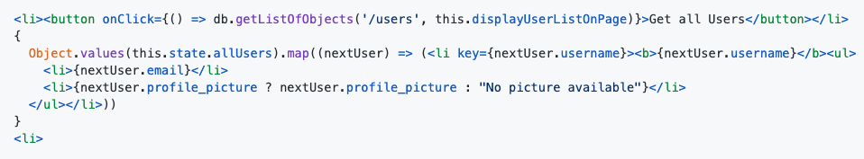
There's two parts here - call the 'getListOfObjects' method, specifying where to find the list in the JSON document / database, and specifying the function to call once we've gotten our response from the database.
The JSX / HTML then displays that list on the page (which will happen once we've called setState with the new list)
Here's how we might call the code inside, say, a render method of a component:
This is the function that actually updates the React state with the new list.
After checking for an error (which in this case would show up as an empty array) we print the contents of the array to the console and then call setState to re-render the page.
Notes:
This method looks really similar to the other method. So similar that we could probably get away with a single version instead of having two separate methods for this :)

Slide 30
CRUD: Update

Slide 31
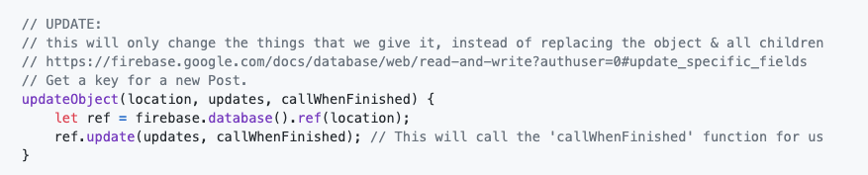
Useful for
Changing part of an object in the database (in contrast to set, which replaces the entire object with a new object)
MyFirebase.js:

Slide 32
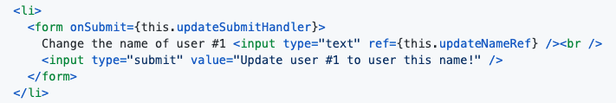
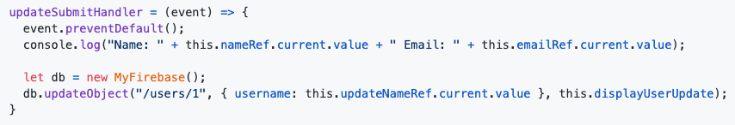
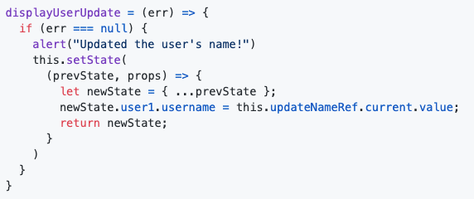
Useful for
Changing part of an object in the database (in contrast to set, which replaces the entire object with a new object)
Notes:
Given a spot in the database and a partially filled in object, we'll call the Firebase .update() method and then wait for .update() to call our callback function when it's done.
We're using the React uncontrolled form elements here, too. We make sure that we stop the default action for the 'submit' button (which causes a page refresh), and then call the updateObject method that we defined in our Firebase file, handing it the displayUserUpdate function to call when it's done.
Here we update React's copy of the information in the database. This will trigger a re-render of the page, which will cause user #1's name to show up because of our previous HTML/JSX

Slide 33
CRUD: Delete

Slide 34
Useful for
Removing an object from the database
When a user deletes their account, or cancels an order, or your store decides to stop stocking an item then you might decide to delete the object in the database that represents the user's account / order / item info.

Slide 35
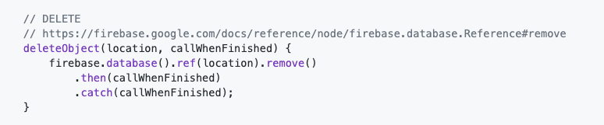
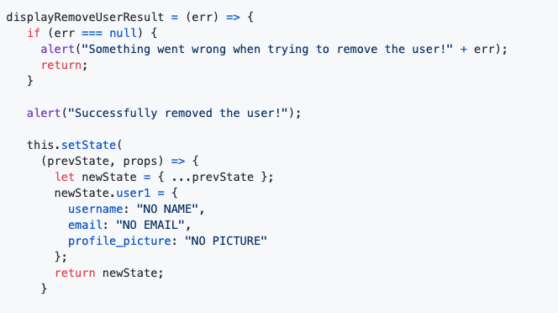
Delete
Example code providing this functionality, inside MyFirebase.js
Example code providing displayRemoveUserResult:
Here's how we might call the code inside, say, a render method of a component:

Slide 36
Small Group Work Time

Slide 37
Work on YourShare Project
If you haven't yet, clone the current group project to your machine
Identify the components used in the App
Using React Bootstrap, implement a Layout Grid using React Bootstrap <Container/>, <Row/>, and <Col/>
You can implement a React Bootstrap <Table/>, akin the project specifications
Apply what you learned on the YourShare project.
Each team member enhanced the screen she/he is responsible of with Bootstrap components/Fluent UI and Lottie elements.

Slide 38
Create Branches
Create a new branch
Two-step method: $git branch NEW-BRANCH-NAME creates the branch and $git checkout NEW-BRANCH-NAME switch to the new branch
There’s a shortcut to create and checkout a new branch at once. You can use the -b option (for branch) with git checkout. The following commands do the same thing:
$git checkout -b NEW-BRANCH-NAME
Edit, add and commit your files.
Check branches in your local :
To see local branches, run this command: $git branch
To see remote branches, run this command: git branch -r.
To see all local and remote branches, run this command: $git branch -a.

Slide 39
Push Branch to remote repository & Pull from Remote to Local
Push your branch to the remote repository: $git push -u origin feature_branch_name
check the remote repository in GitHub.
the -u flag (upstream) when you make your first push to track a remote branch
Pull from the remote branch:$ git pull --rebase origin <Branch-Name>
Other useful Commands to work on Branches
Rename a branch - To rename a branch, run the command: $ git branch -m OLD-BRANCH-NAME NEW-BRANCH-NAME Alternative git branch --move OLD-BRANCH-NAME NEW-BRANCH-NAME
Delete a branch - Git won’t let you delete a branch that you’re currently on. You first need to checkout a different branch, then run the command: $ git branch -d BRANCH-TO-DELETE - Alternative: $git branch --delete BRANCH-TO-DELETE

Slide 40
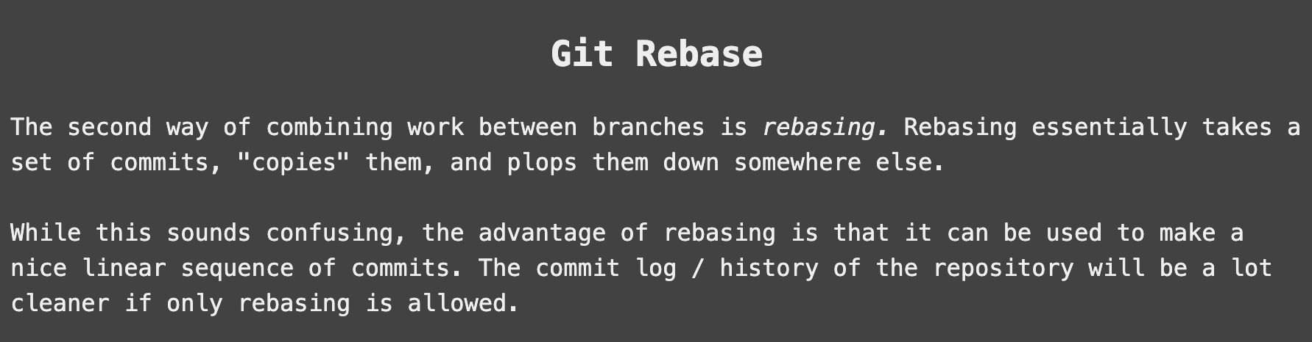
$ git pull --rebase origin <Branch-Name>

Slide 41
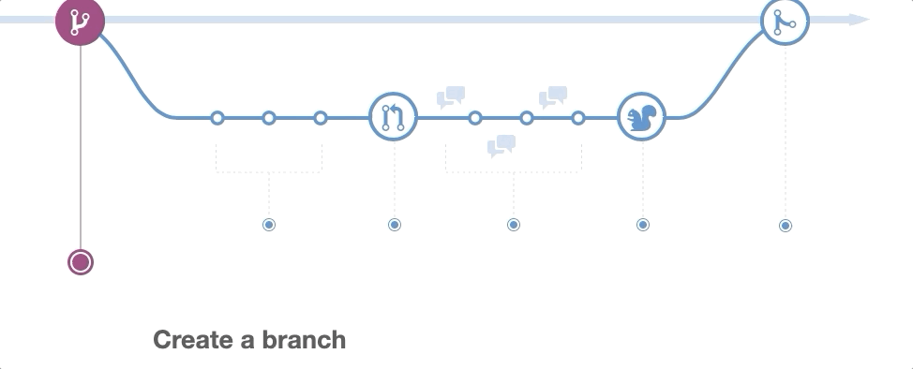
GitHub Workflow

Slide 42
Demo 2 Pull Request and Git Conflict

Slide 44
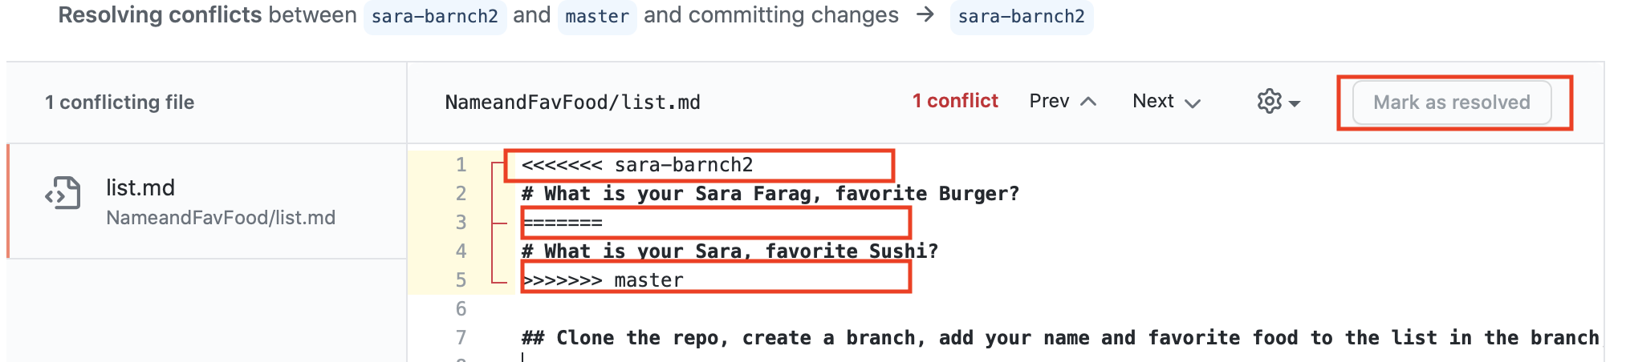
Git Conflict

Slide 45
Demo 3 Push and Pull From Remote
Notes:
store (something) safely and secretly in a specified place.

Slide 46
Play with this Interactive online tutorial for practicing Git branching
Learn Git Branching

Slide 47
Your Turn: 20 mins Game Time

Slide 48
Game Play
Open Sara-GitHubGame
https://github.com/tnt-summer-academy/21-Sara-GitHubGame
Follow the instructions and Complete the Game.

Slide 49
Poll for questions
What went well?
What was difficult?

Slide 50
Your Turn: Small Group Stretch Activity

Slide 51
In Your Small Group
Start a Cheat-sheet from all the commands you learned about git and GitHub so far
Share your cheat-sheet in General Channel for everyone to check/compare and fill the missing gaps

